Slide 1

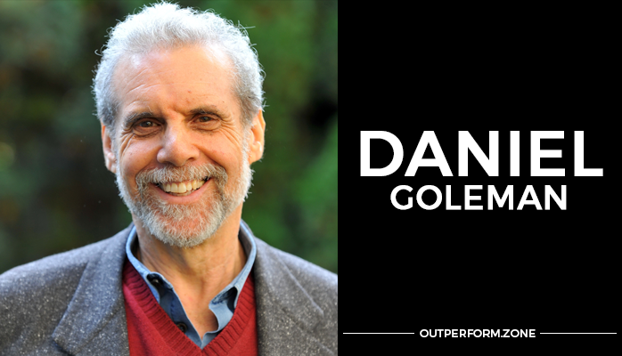
Mixed Model

Slide 2
EQ or EI is: A term created by two researchers – Peter Salavoy and John Mayer – and popularized by Daniel Goleman in his 1996 book.

Slide 3
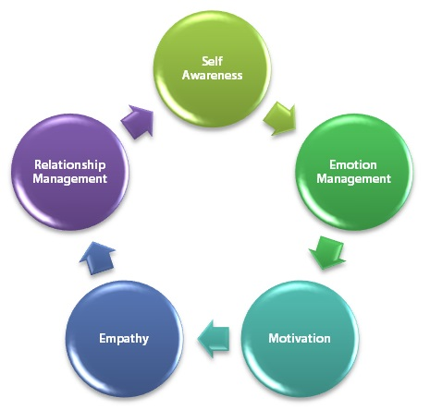
This model uses "The Five Components" to efficiently describe emotional intelligence.

Slide 4
Self Awareness:
A Powerful Tool for Leaders
“the need to know and the fear of knowing”
-Abraham Maslow (1968)

Slide 5
“Self-awareness (sometimes also referred to as self-knowledge or introspection) is about understanding your own needs, desires, failings, habits, and everything else that makes who you really are.
The more you know about yourself, the better you are at adapting life changes that suit your needs.

Slide 6
ACTIONS
What people see
EMOTIONS
THOUGHTS
BELIEF SYSTEMS
What you feel
What you think
Generated from your value system

Slide 7
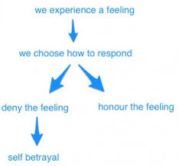
Self-Betrayal Model

Slide 8
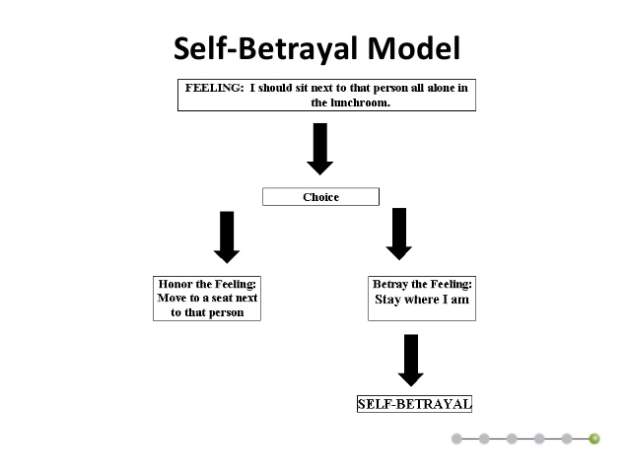

Slide 9

SELF REGULATION

Slide 10
Self regulation is mostly about being able to control/ manage your emotions and responses to situations and other people.
But it's also about feeling positive emotions and expressing positive emotions to others.

Slide 11
Sometimes it's okay to let emotions control us, especially when it comes to positive emotions.
Your excitement and joy at passing an exam, or achieving a target for the month, are appropriate expressions of emotion.
But it's not great to be controlled by negative emotions such as anger, fear or frustration.

Slide 12
Emotional intelligence suggests that it's important to be aware of all our emotions. When we're aware, we can choose how to react and express our feelings.
Self regulation is about using self awareness to keep negative reactions under control.

Slide 13
MOTIVATION

Slide 14
Self-motivated leaders work consistently toward their goals, and they have extremely high standards for the quality of their work.
Motivation is something that we strive to improve or meet a standard of excellence.
2 types of Motivation
      Intrinsic
      Extrinsic

Slide 15
  Intrinsic motivation also plays a key role in emotional intelligence.
  People who are emotionally intelligent are motivated by things beyond mere external rewards like fame, money, recognition, and acclaim.
  Instead, they have a passion to fulfill their own inner needs and goals.
  They seek things that lead to internal rewards, experience flow from being totally in tune with an activity, and pursue peak experiences.

Slide 16
People with this competence:
•• Are results-oriented, with a high drive to meet their objectives and standards
•• Set challenging goals and take calculated risks
•• Pursue information to reduce uncertainty and find ways to do better
•• Learn how to improve their performance

Slide 17
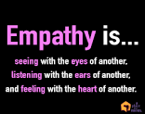

Slide 18
WHAT IS EMPATHY?
Empathy is the capacity to understand or feel what another person is experiencing from within the other being's frame of reference, i.e., the capacity to place oneself in another's position.
Empathy connects people together.
Empathy heals.
Empathy builds trust.
Empathy closes the loop.

Slide 19
EMPATHY VS SYMPATHY
EMPATHY
SYMPATHY
Empathy is about feelings.
Empathetic people are often very sympathetic.
Sympathy is about actions.
A person who is sympathetic but not empathetic may appear a little shallow.

Slide 20
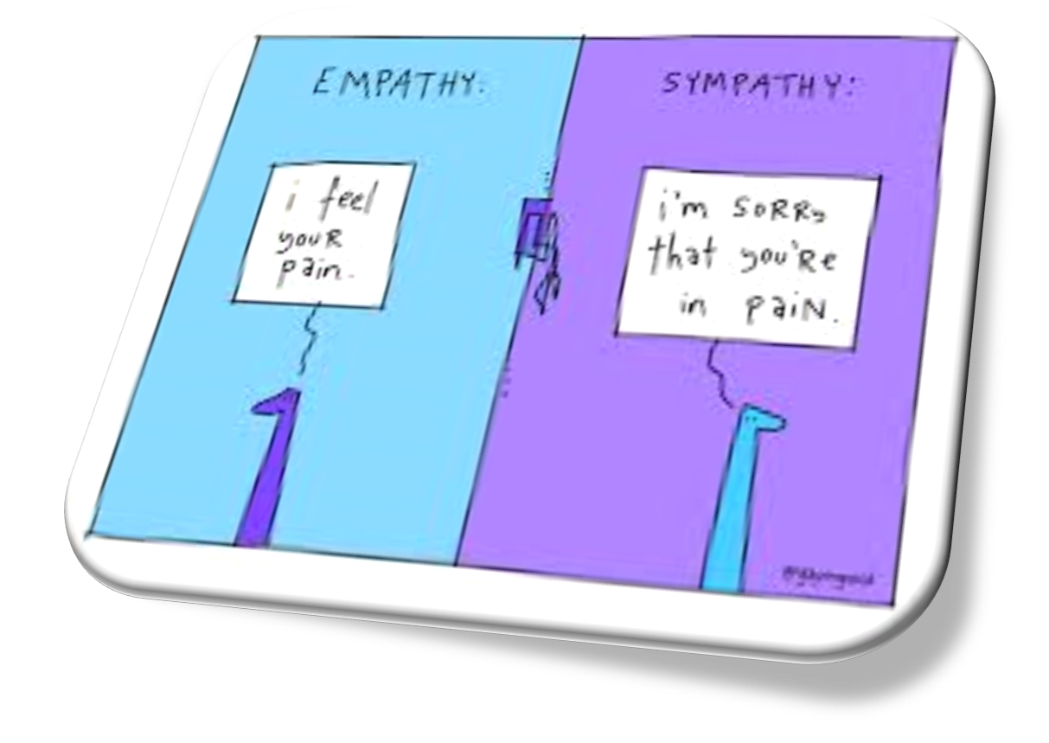

Slide 21

INTERPERSONAL SKILLS

Slide 22
Being able to interact well with others is another important aspect of emotional intelligence.
True emotional understanding involves more than just understanding your own emotions and the feelings of others - you also need to be able to put this information to work in your daily interactions and communications.

Slide 23
Interpersonal intelligence
(people smart)
It is the ability to understand and interact effectively with others. It involves effective verbal and nonverbal communication, the ability to note distinctions among others, sensitivity to the moods and temperaments of others, and the ability to entertain multiple perspectives.

Slide 24
Interpersonal skill is the reciprocal social and emotional interaction between two or more individuals in an environment
Close association between individuals who share common interests and goal

Slide 25
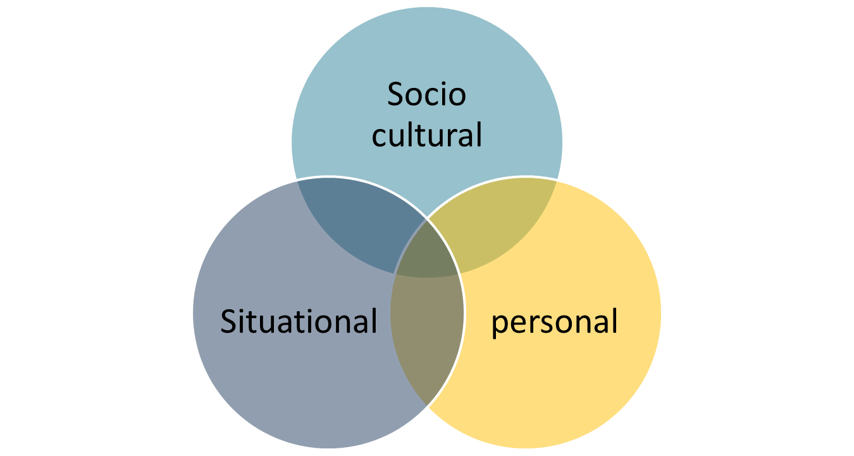
Barriers to IPR

Slide 26
Summary
Self-Awareness (confidence, recognition of feelings)
Self-Regulation (self-control, trustworthiness, adaptability)
Motivation (drive, commitment, initiative, optimism)
Empathy (understanding others feelings, diversity, political awareness)
Social Skills/ Interpersonal skill (leadership, conflict management, communication skills

